Slide 1
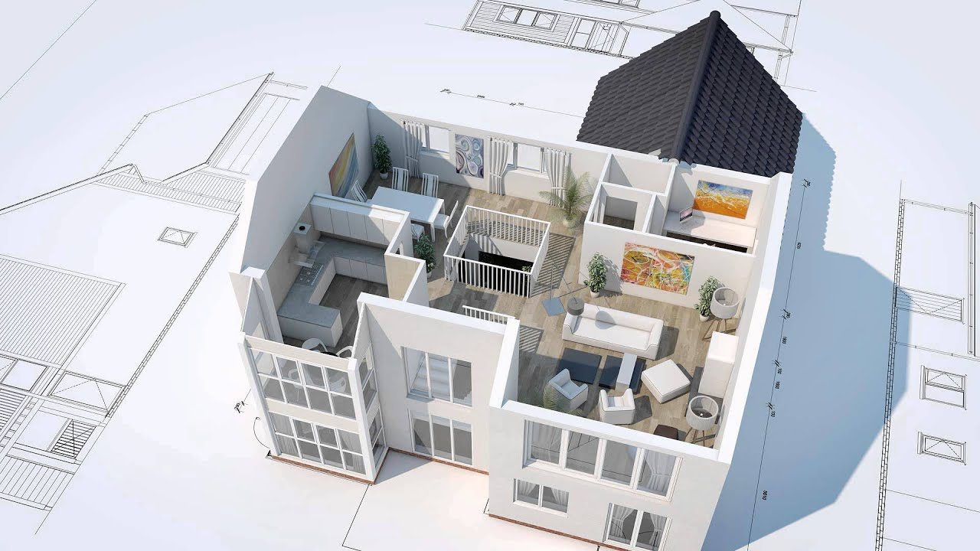
AUTOGENERATION OF 3D MODEL FROM ROOM IMAGES
2016-CE-54
2016-CE-72
2016-CE-81
2016-CS-159

Slide 2
1. OVERVIEW OF PROJECT

Slide 3
1.1 PROBLEM STATEMENT

Slide 4
1.2 MOTIVATION

Slide 5
2. OBJECTIVE OF PROJECT

Slide 6
3. SCOPE OF THE PROJECT

Slide 7
4. IDEA COMPLEXITY

Slide 8
5. EXISTING SYSTEM

Slide 9
6. PROPOSED SYSTEM

Slide 10
7. METHODOLOGY

Slide 11
8. POSSIBLE APPLICATION OF WORK

Slide 12
9. MARKET SURVEY

Slide 13
10. FEASIBILITY STUDY

Slide 14
11. TARGET AUDIENCE

Slide 15
12. LIMITATIONS AND CHALLENGES

Slide 16


